Slide 1
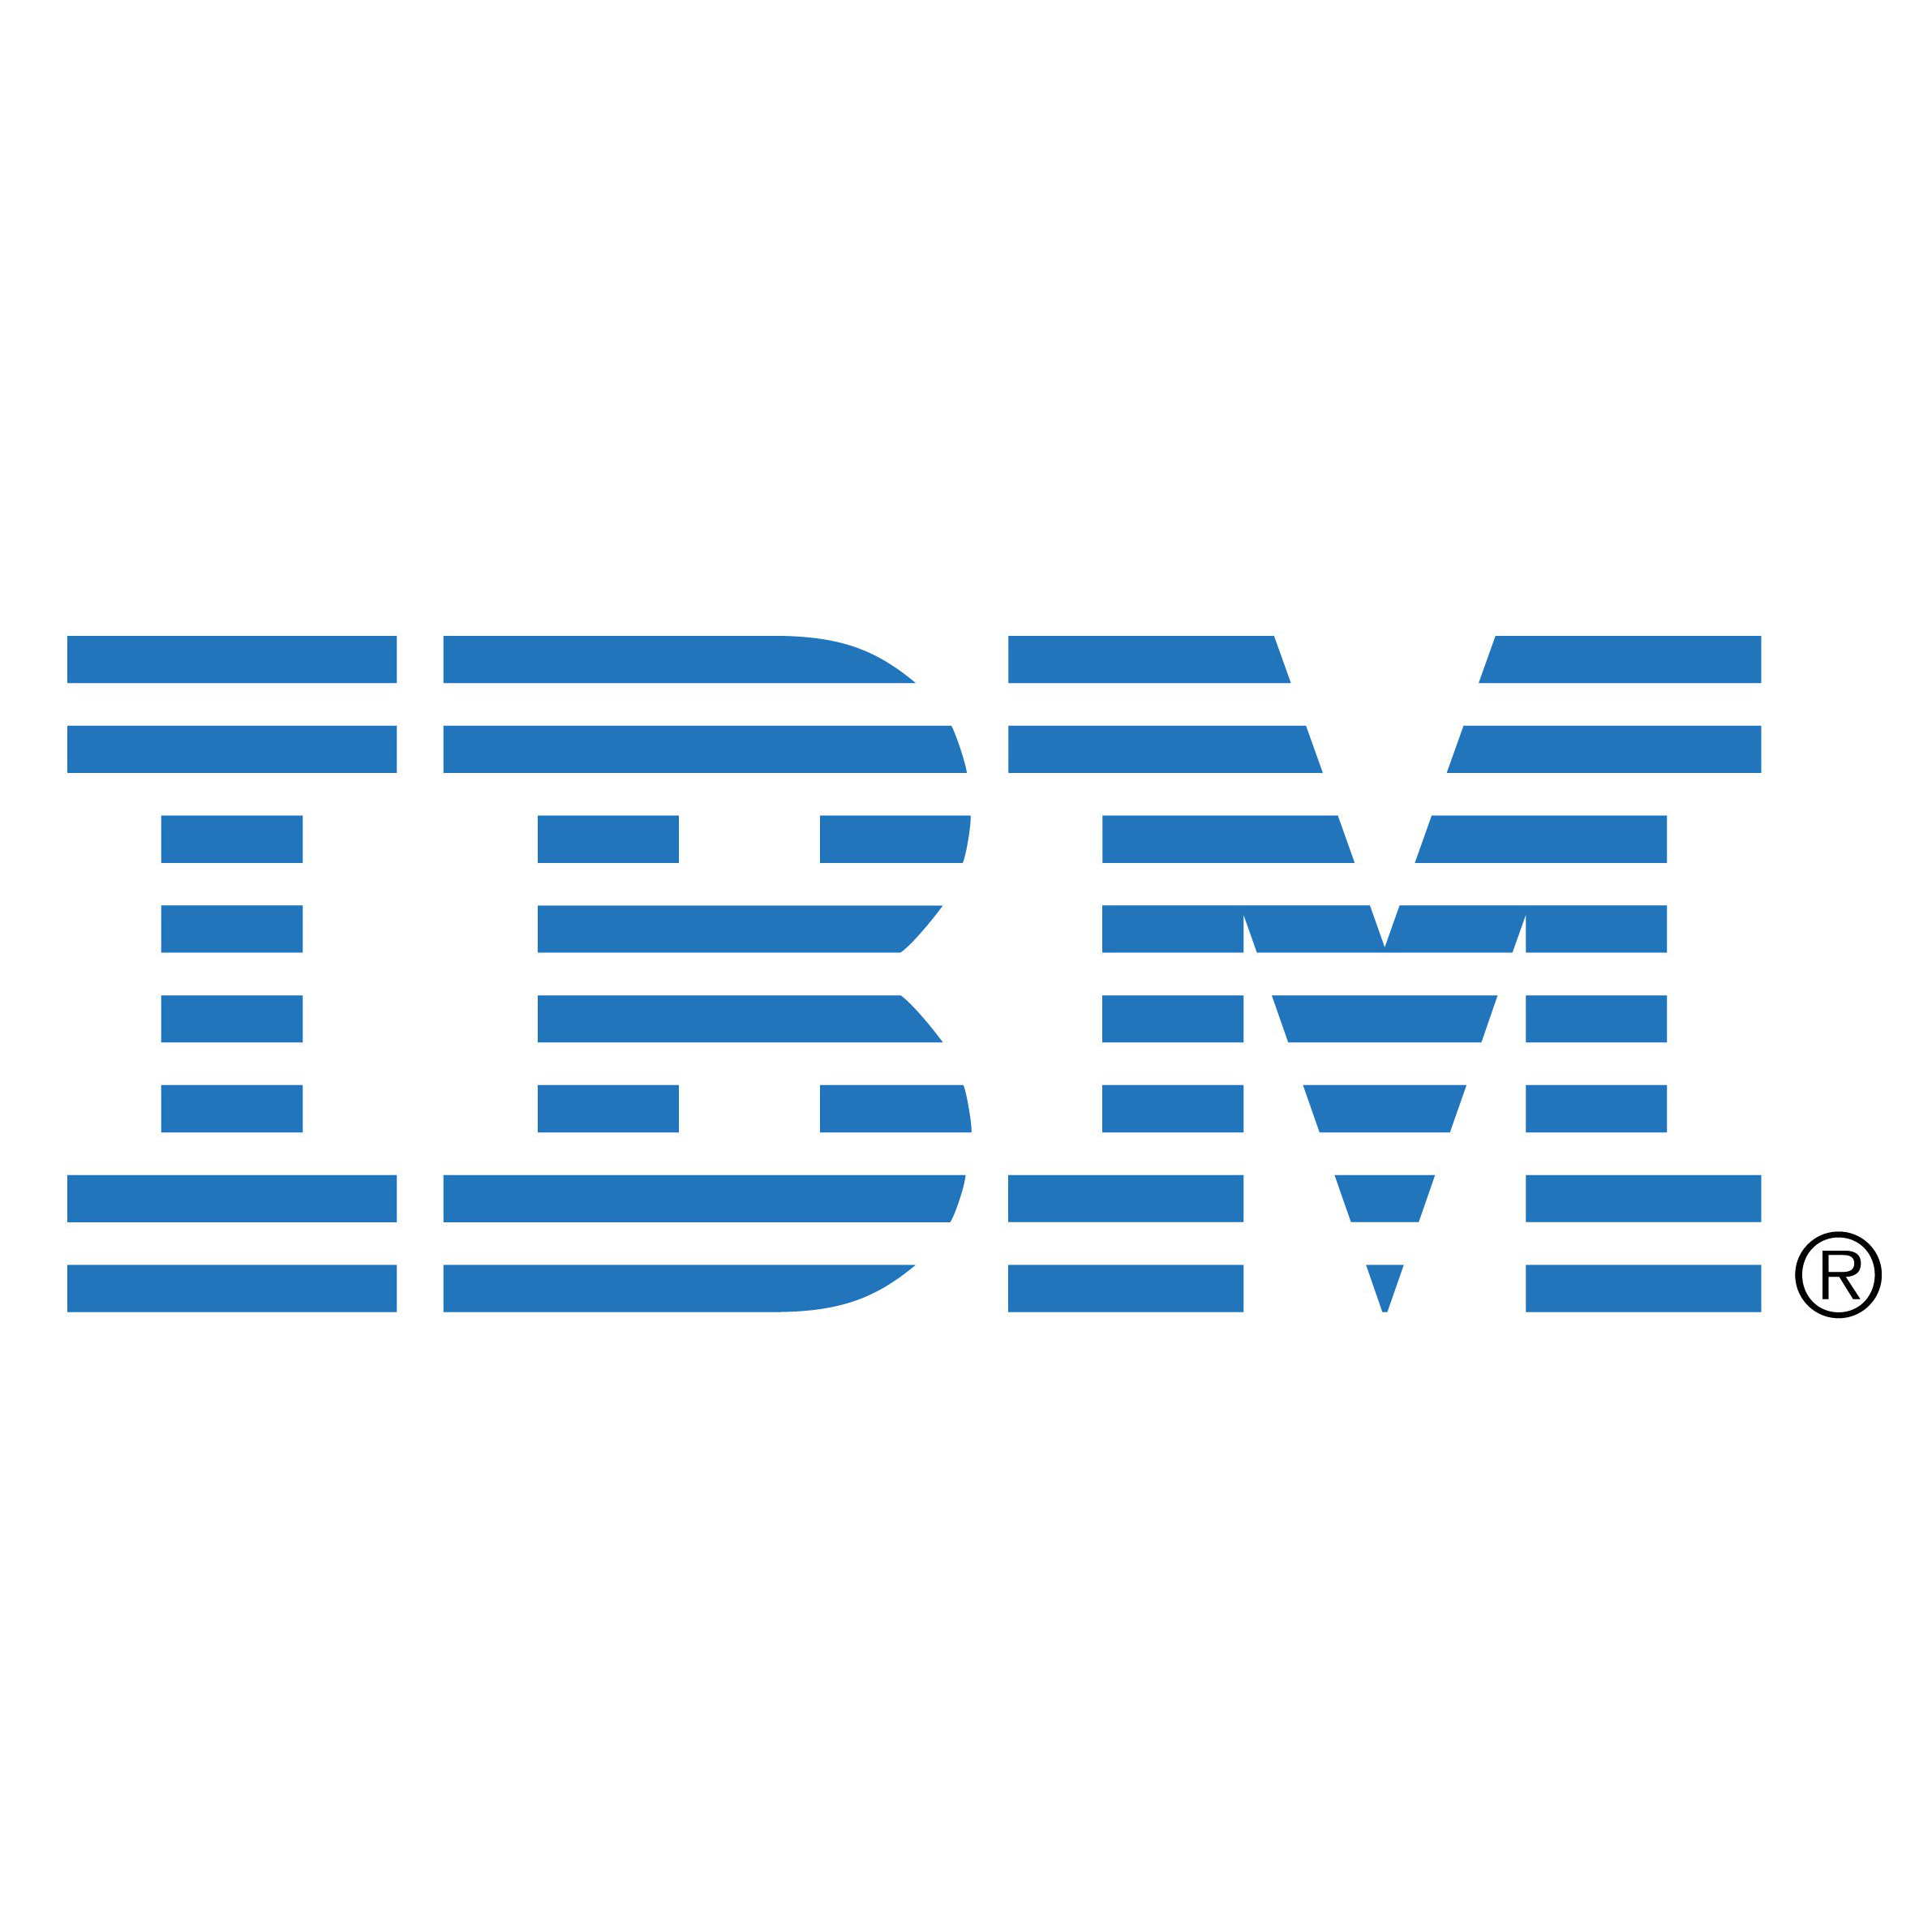
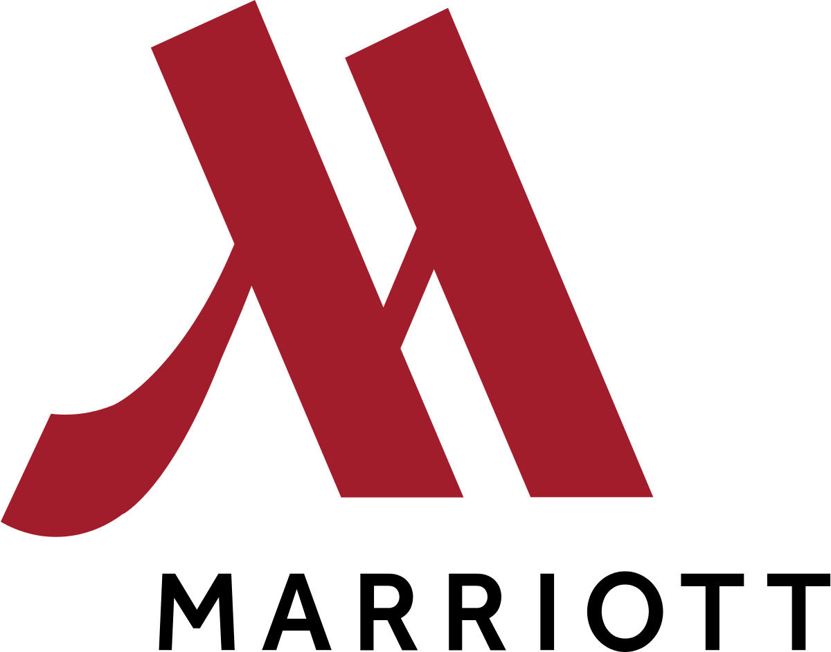
Blue Prism Robots – Secured way to do Business Aug 2018

Slide 2
RPA Security : Clarifications
1. How the robot would connect with the Marriott database and how secured it is?
Robot does not connect to database directly. It uses the same user interface as a human engineer. So database connection is managed by the applications , on which the operations are automated.
2. How do you manage the log-in credentials? Does the password stored in a shared database? How secured it is to store data in a shared database?
User id credentials are stored in AES encrypted way. Database is only read by Robot, there is no human access to the production environment.
3. How would you manage the password change process (Marriott has a mandatory 90 day password change policy)?
A. If the password can be changed using a formula, or reset through email, we can have an Automation that runs once in 89 days and change the password.

Slide 3
RPA Security : Clarifications
4. What information would be stored in IBM cloud? Will it cause any data breach or raise concerns on data privacy? What other information will be stored on Cloud?
No information will be stored in IBM cloud except user credentials. Apart from the credentials, It will just store the Automation running status, and if the Automation fails for some reason what action it should take. This will not store or manipulate any PI/SPI data.
5. When robots are shared between clients, how do you ensure other clients don't have access to our data?
If you pay per day basis, your robot will be dedicated to Marriot. It will not be shared with other clients
Q. What are the requirements, if Marriott want to host the robot in it's own environment? Who would maintain the robots and how?
A. If Marriott hosts it themselves the management of Robots are their responsibility. However IBM can do the AMS for the Robots.

Slide 4
Clients and their Network Topologies
List of Clients where connectivity is through internet
Client | IOT | Sector | Reason
MARRIOTT INTERNATIONAL INC | North America | Distribution | Application can be connected over the internet.
National Grid | North America | Communication | Service Now is hosted on cloud
Pitney Bowes | North America | Industrial | Application connected through direct Citrix VPN
Panasonic | North America | Industrial | Application can be connected over internet.(SOCKS/ Internet)
Amerisource Bergen | North America | Distribution | Application can be connected over the internet.
AECOM | North America | Industrial | Applications available from IBM port
KLA Tencor | North America | Industrial | Applications available from IBM port
NOV | North America | Industrial | Applications available from IBM port

Slide 5
Clients and their Network Topologies
List of Clients where connectivity is through SSL VPN
Client | IOT | Sector | Reason
Mills Fleet Farm | North America | Distribution | Cisco VPN
List of Clients where connectivity is through S2S VPN
Client | IOT | Sector | Reason
Medtronic | North America | Industrial | Connectivity through Citrix didn’t work (S2S in progress for Prod env, Test env is done)

